Slide 1
Financial Literacy
By: Leon Moody, Sr.
Alabama Director of Bigger and Better

Slide 2
Financial Literacy Vocabulary Assignment
Directions: Using the vocabulary we just went over, you are to pick two words.
After picking your 2 words you are to create a “poster” for each word on a separate pieces of computer paper. Your poster needs to include the following:
  The word
  The definition
  A picture or symbol clearly showing what the word means
  A sentence clearly showing an understanding of the word's meaning with the vocab word included in the sentence.
  Color and creativity

Slide 3
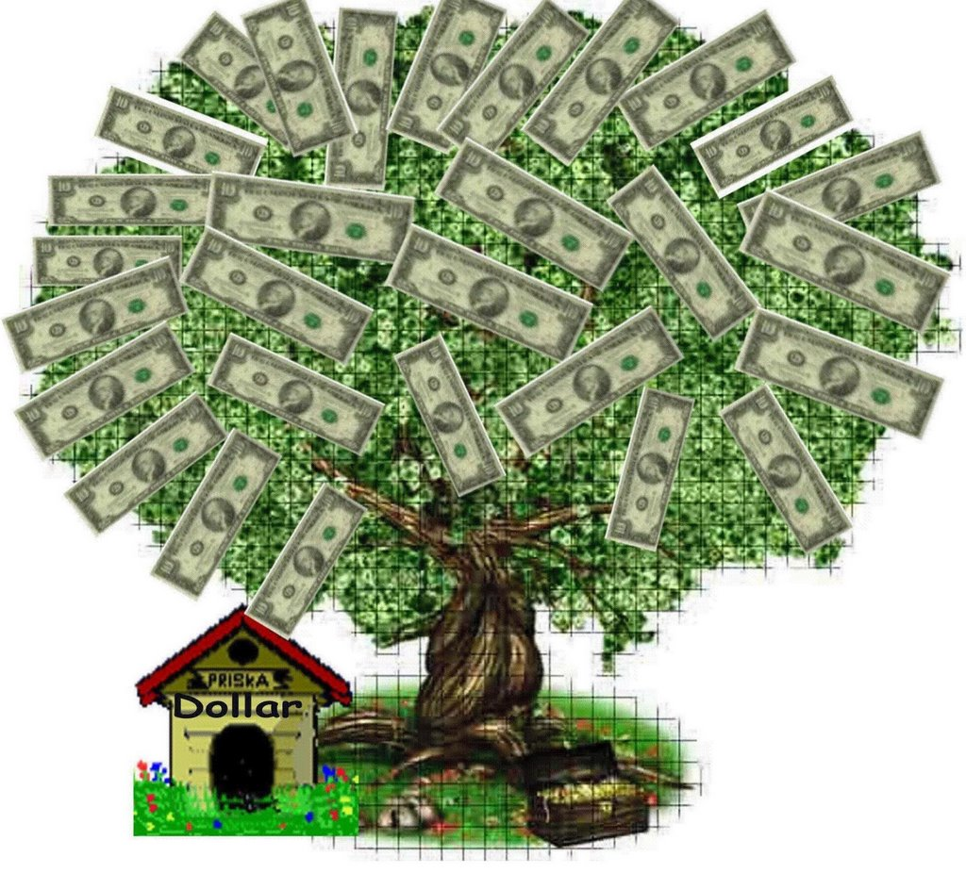
Where does money come from?
One things for sure, it doesn’t grow on trees!
Even though we wish it did.
How money is printed

Slide 4
Introduction

Slide 5
Complete the questionnaire on your notes. We will discus your Reponses in a few minutes.

Slide 6
Survey
Do you currently have a savings account?
Do you currently have a checking account?
Do you plan on owning or currently own a car?
What is a good interest rate for a car loan?
Do you plan on owning a house one day?
What would you do to finance your house?
What is a down payment?
Can you purchase a house without a down payment?
Do you currently have a credit card or loan?
What is a co-signer?
What happens if you have a co-signer on a loan and you neglect your payments?

Slide 7
Basic Vocabulary
Revenue—what you earn
Expenses—what you spend
Net Profit—total revenues minus total expenses
Net Income—same as net profit
Depreciation—reduction in value over time
Appreciation—increase in value over time
Equity—ownership in a company

Slide 8
More Vocabulary
Vesting—earning equity over time instead of all at once
Asset—something you own that has value
Liability—something you owe for
Balance—the difference between credits and debits in an account
Bond—debt instrument through which companies and governments can raise money

Slide 9

Why study financial literacy?
The state says we need to!
The number of foreclosures and bankruptcies are increasing.
Unemployment continues to be unstable.
Credit card use has gotten out of control.
You have the chance to be smart with your finances from the very beginning!

Slide 10
Vocabulary Assignment
Using the definitions just given to you, you need to create a sentence (that includes the vocab word!) and picture that represents the vocabulary word. This is your LAST vocab assignment for the year!!!

Slide 11
Spending Money & Debt

Slide 12
Do you never have enough money?
Some spending is inevitable and important, while others could be kept in check
Housing/Utilities
Food
Transportation
Retirement
Education
Health Care
Insurance
Household Supplies
Savings
Entertainment
Personal Care Products
Charitable Donations
Taxes
Miscellaneous

Slide 13
What do I do?
Mortgage: $900
Utilities: $175-$225
Groceries: $500
Transportation: $200 for gas a month
Car Payment: $180
Retirement: $400
Education: $200 for my student loan
Health Care: $200
Insurance: $175 a month
Household Supplies: varies--$200 a month
Savings: $400 a month
Entertainment: $150
Donations: $500
Other - $1,500
  Internet
  Credit Cards
  Shopping
  Gifts

Slide 14
What do others do?
Food is a huge expense for people!
  81% of consumers are spending more or the same on groceries as they were 2 years ago
How can people save money on food?
How can you cut back on other expenses?

Slide 15
Paying Taxes

Slide 16

How We’re Taxed
We are taxed when we work, and often taxed when we make a purchase
On April 15th each year, we mail in forms showing what we’ve paid in local, state, and federal taxes.
  Sometimes we get a refund (because we’ve overpaid)
  Sometimes we owe more (because we didn’t pay enough)

Slide 17

Why We’re Taxed
What kinds of goods and services does the government provide?
  Education
  Defense
  Welfare
Where does it get the money to do this?
  From Taxes!
  Consumer Rights
  Disability
  Environment
  And now Health Insurance

Slide 18
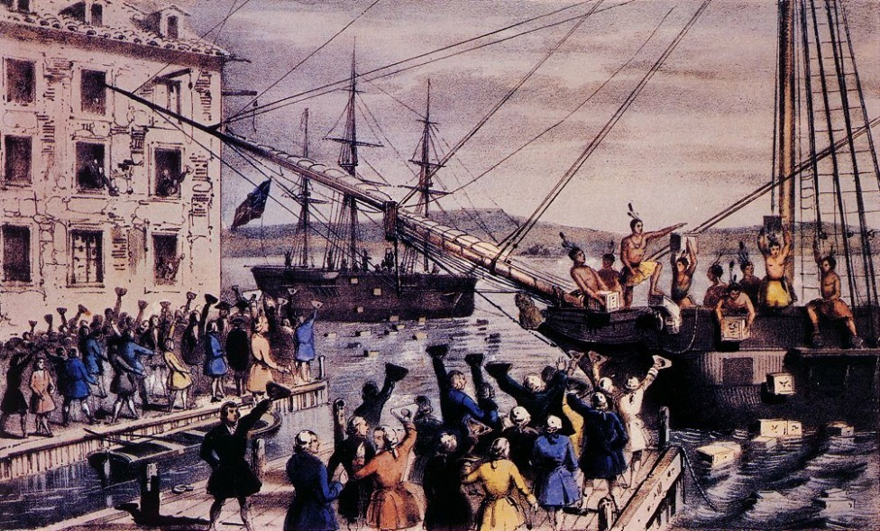
The U.S. History of Taxation
Remember the Colonists were not thrilled to be taxed—hence the Boston Tea Party
The Revolutionists were upset!
No taxation without representation!

Slide 19

Why They Can Tax
After the Revolutionary War, we were in debt! We needed taxes to pay that debt off
Article I, section 8 of the U.S. Constitution gave Congress the right to tax
The 16th Amendment added an income tax

Slide 20

Can We Skip Taxes?
Failure to pay your taxes legally due is called Tax Evasion.
  Some don’t report all income
  Some don’t file at all
  The penalty can be financial or even jail
We can legally try to decrease our taxes through Tax Avoidance.
  We claim as many deductions as possible to lower the amount we owe

Slide 21
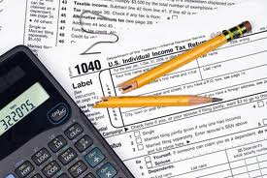
Filing Taxes
All the forms you’ll need can be found at the IRS website.
  You need the forms
  You need your W-2 and proof of income
  You need any investment and banking papers
  Any education expenses or charity donations
If you haven’t received your W-2s by February 15th, you can report your employer to the IRS
You CAN file your taxes on your own!

Slide 22
Credit Cards

Slide 23
Credit
The definition of credit is the borrowing capacity of an individual or company
You cannot borrow money without a credit history; sometimes a lender will require a co-signer
You build your credit history by
  borrowing money and paying it off
  paying bills on time

Slide 24

Credit Scores
Most lenders use the FICO method
The numbers range from 300 to 850
The higher the score, the better your credit
Your score is based on
  Your payment history (35%)—higher if you pay on time
  Outstanding debt (30%)—an if you owe more than you earn
  Length of credit history (15%)—how long you’ve been borrowing money
  New credit (10%)—getting a new card or loan
  Types of credit (10%)—are you diverse?

Slide 25
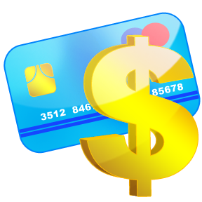
Warning: Careful How You Spend
Keeping your credit score healthy allows you to take out loans with a lower interest rate
  Lower Interest Rate = Lower Payment!
Your credit limit = The amount you are approved for on a credit card
  You cannot go over your limit!
Make sure to only use 30% of your credit limit, to keep your score healthy and high
  i.e. $100 Credit Limit = Spending no more than $30 a month
  i.e. $7,000 Credit Limit = Spending no more than $2,100 a month

Slide 26

Credit Card Use
Positives
Negatives
You can buy something when you don’t have the cash for it
Safer than carrying cash
Easier to use than a check
Helps establish credit
Easier to spend money you don’t have
Need to pay interest—and rates vary
Can charge an annual fee
Penalties for late or missed payments

Slide 27
How do I Get a Credit Report
Free Credit Reports—don’t trust the commercials!
Online: Visit AnnualCreditReport.com
(This is the ONLY site that's truly free! Don't be fooled by ads saying otherwise.)
Due to the passage of the 2003 Fair and Accurate Credit Transaction Act (FACTA), all Americans are entitled to one free credit report from each of the three major credit reporting agencies—Equifax, Experian and TransUnion—upon request every 12 months.

Slide 28
Insurance

Slide 29
Purpose
To protect yourself or your family against the financial impact of a tragedy

Slide 30
Different Types
Health: can cover everything or just hospitalization
Life: to help your family after you die; should help with the lost income of the insured
Auto: required by law; helps when a car is severely damaged
Home Owners: protects against natural disasters, fires, or someone who is injured at your home
Renters: protects the items inside the house
Product: on a specific purchase

Slide 31
Important Tips
Carry a high deductible to keep premiums low—hopefully you won’t ever need the insurance
Don’t over-insure old cars—you won’t get enough money for a brand new car
Keep careful records so replacement isn’t an issue

Slide 32
Insurance Vocabulary
Complete the crossword puzzle using the following words:
Actuary | Adjuster | Agent | Annuity
Arson | Burglary | Carrier | Catastrophe
Claim | Conditions | Coverage | Deductible
Depreciation | Exclusion | Fraud | Hurricane
Insured | Limit | Loss | Maturity
Peril | Policy | Policyholder | Premium
Rate | Schedule | Term | Write

Slide 33
Banking & Savings Accounts

Slide 34
There are five different types of accounts that are available at most banks.

Slide 35
Checking Account
Uses a check as the primary manner of withdrawing money
Can also use a check to make purchases
Most have ATM/Debit cards attached to them

Slide 36
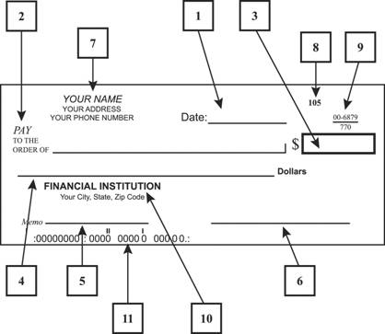
Writing a Check
Date
Who you’re paying
Dollar amount in numbers
Dollar amount in words
Optional memo
Signature
Name/Address/Phone
Check Number
Codes for the bank
Codes for the branch
Routing number

Slide 37

Savings Account
Keeping your money “in the bank”
Often limits the number of deposits and withdraws per month
Need to keep a minimum amount
Earns interest
Insured by the federal government

Slide 38

Money Market Account
Money is deposited, just like in a savings account
Instead of just sitting in the bank, the money is invested
Also insured by the government
A very safe investment, but lower returns

Slide 39

Time Deposits
Also known as Certificates of Deposit (CDs)
Money is held in an account for a fixed period of time
There’s an agreed upon rate of return prior to the deposit
Advanced notice must be given to withdraw the money

Slide 40
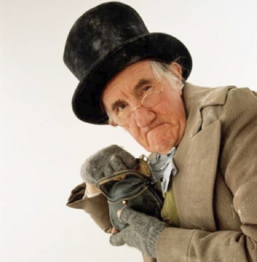
No-Frills Bank Account
An account with no bells or whistles
Will not require a lot of fees
In other words, it’s a cheap alternative (like shopping at Aldi’s instead of Heinen’s)

Slide 41
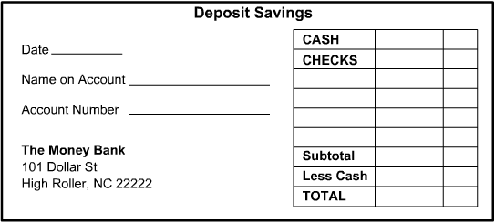
Deposit Slips
1
5
2
3
6
Date
Name on the Account
Account Number
Bank Information
Cash you are putting
into the account
6. Amount of money you
are putting into the account via checks
7. Subtotal: The total amount on the slip, of both money and checks
8. Less Cash: If you want to keep money out of the subtotal. i.e. If you put
$1,000 on the deposit slip but want $50.00 cash back you would only be
putting $950 in the account.
9. Total: The total amount you are putting into the account. Subtotal, minus
less cash.
4
7
8
9

Slide 42
Investing

Slide 43

Definition
Investing is the act of committing money or capital to an endeavor with the expectation of obtaining an additional income or profit.
In other words, making money off the money you already have!

Slide 44

Stocks
A portion of an ownership in a corporation
If you own stock, you own a share in the company
Buy and sell through a broker who trades on the Stock Exchange

Slide 45
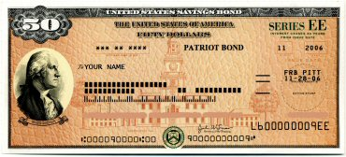
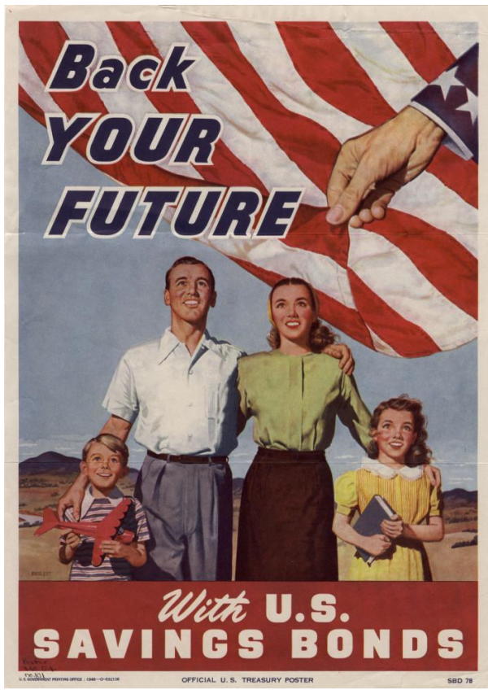
Bonds
Issued by some large entity—a bank, the government, or a company
Pay out a specific amount at a specified time
Pays out less prior to that specified date

Slide 46
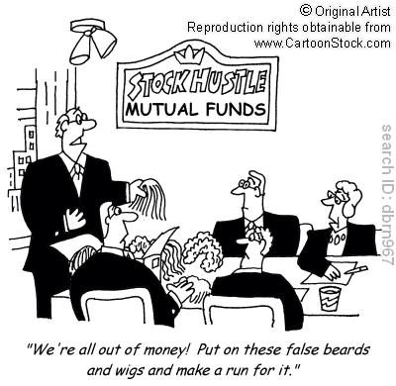
Mutual Funds
Operated by an investment company
Takes money from investors and buys a number of stocks, bonds, etc.
Have a portfolio of accounts, not a lot of one type

Slide 47
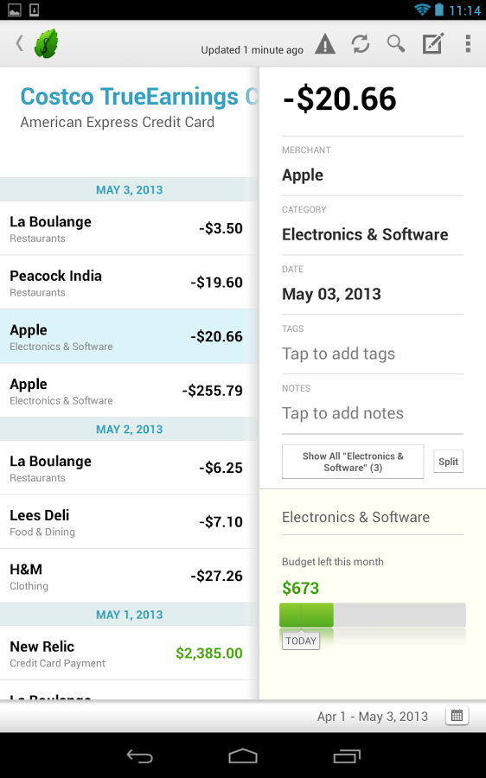
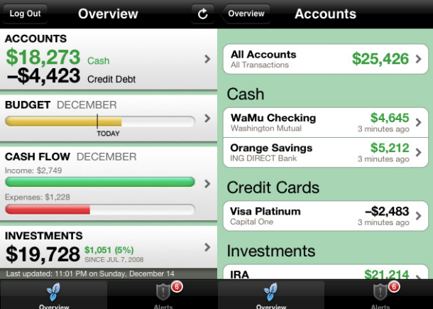
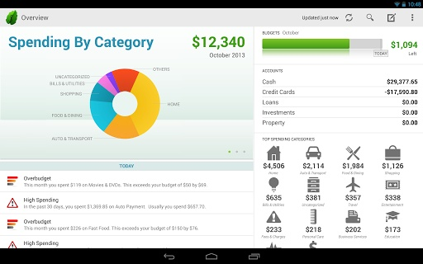

Let Me Introduce…
Mint
  What is it: A personal finance, budgeting money management website and app

Slide 48
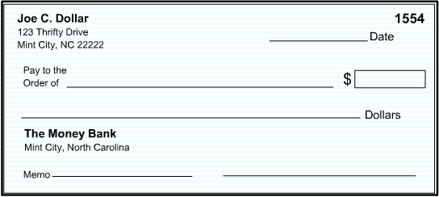
Writing a check 101
5/13/15
Ford Auto
592.89
Five Hundred Ninety-Two & 89/100
Shayla Greer
Acct #: 321876004
Bill for: Ford Auto • Price: $592.89 • Account Number: 321876004

